Slide 1

A Marvel Investment
Project #1
Team #6

Slide 2

Motivation & Summary Slide
Since it’s inception in 2008, Marvel Studios has spent 3.9B$ on producing movies!
In 2018 alone, Marvel spent 683M$ on just 3 films.
This staggering level of investment undoubtably demands tons of research to ensure ROI on Marvel’s part, but as newbies of the data analytics world, we’d thought we’d double check for Marvel…just in case!
So our team went about confirming whether or not Marvel made all the right investments in their multimillion dollar movies by comparing Marvel’s top five movie investments against their top five highest box office sales as well as viewer’s top five rated movies.
“Shockingly”, for the most part, Marvel made all the right decisions. Our analysis, however, did find some interesting tidbits along the way.
Notes:
Define the core message or hypothesis of your project.
Describe the questions you asked, and why you asked them
Describe whether you were able to answer these questions to your satisfaction, and briefly summarize your findings

Slide 3
Questions & Data
Questions:
Are Marvel’s top five movie investments in line with their top five box office sales?
Are Marvel’s Avenger movies (jammed packed with multiple “main” characters) more profitable than their single character movies?
Is there a correlation between viewer ratings and box office sales?
Approach:
Gather box office sales, budget, and viewer ratings data via movie databases and API’s.
Use Python and Pandas to import, clean, join, and analyze the data.
Use Matplotlib to plot the data and analyze possible trends and correlations.
Data Sources:
OMDb (API), TMDb (API), The-Numbers, Movie, Statisicbrain, Gosocial, Ranker
Notes:
Questions & Data
Elaborate on the questions you asked, describing what kinds of data you needed to answer them, and where you found it
"This product uses the TMDb API but is not endorsed or certified by TMDb."

Slide 4
Tools
Coding:
Python
Cleaning:
Pandas, Numpy, Excel
Displaying:
Jupyter Notebook, Matplotlib, Json, PowerPoint
Sharing:
GitHub, Slack

Slide 5
Data Cleanup & Exploration
OMDb (API):
Pretty straight forward API
Did not appear to include budget data so it forced us to seek another API
TMDb (API):
Provided box office sales and viewer ratings
Provides budget data, but required two calls. First to located unique movie ID by name, then use acquired movie ID’s to call for specific details of desired movies.
Joining Data:
Upon joining the data frames, we discovered that the film names were not formatted exactly the same so we ran a Boolean through the two film name columns and discovered that one API used unique characters. We opted to remove all unique characters.
There were slight discrepancies between the ratings so we took an average.
Splitting /Filtering Data
We decided to separate the multiple major characters Avenger movies from the single main character movies as their budgets were significantly higher.
We decided to only compare domestic sales as the global sales may be skewed by access to various countries.
Notes:
Describe the exploration and cleanup process
Discuss insights you had while exploring the data that you didn't anticipate
Discuss any problems that arose after exploring the data, and how you resolved them
Present and discuss interesting figures developed during exploration, ideally with the help of Jupyter Notebook

Slide 6
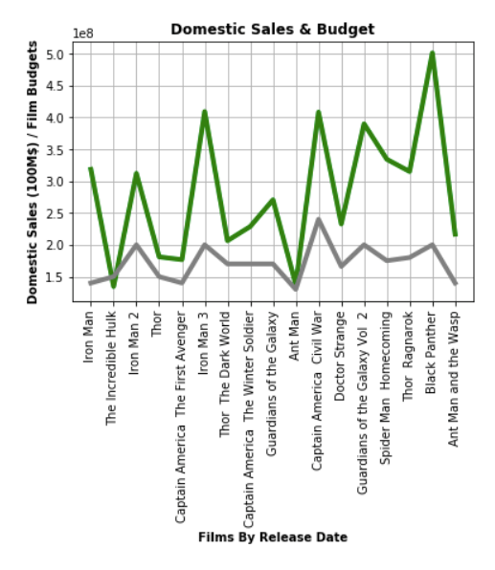
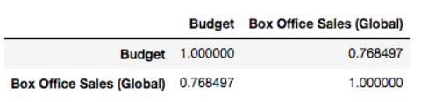
Data Analysis
There is a definite correlation between budget and box office sales. However, there are a few anomalies like The Incredible Hulk (negative) and The Guardians of the Galaxy (positive).
Black Panther is an especially interesting one as it significantly exceeded sales expectations.
"This product uses the TMDb API but is not endorsed or certified by TMDb."

Slide 7
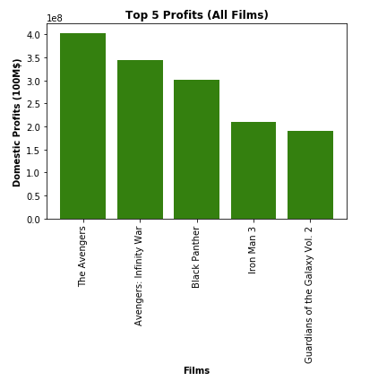
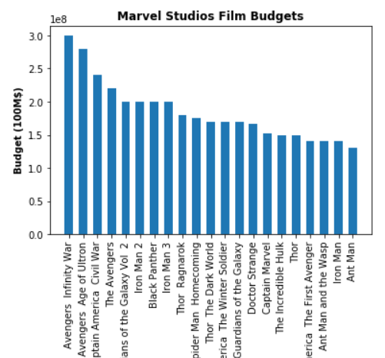

Data Analysis
Our initial assumption was that the big Marvel’s Avenger movies (jammed packed with multiple “main” characters) would be more profitable than their single character movies. While for two of them, that is correct, we actually found three single character movies in the top five.
"This product uses the TMDb API but is not endorsed or certified by TMDb."

Slide 8
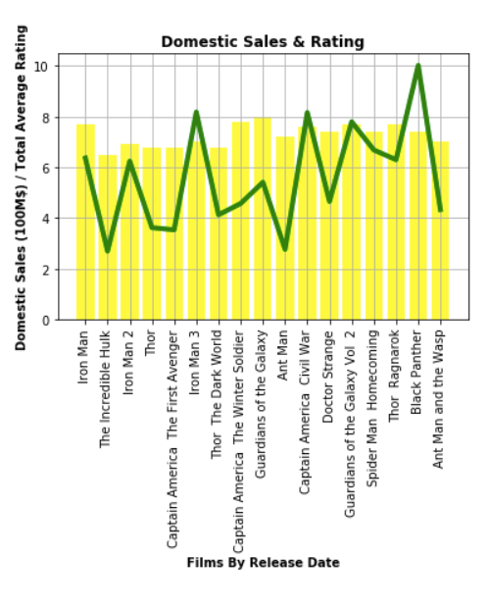

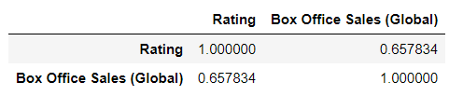
Data Analysis
Our initial assumption was that there would be a strong correlation between how well a movie rated and its box office success, but surprisingly there is low correlation between viewer ratings and box office sales.

Slide 9
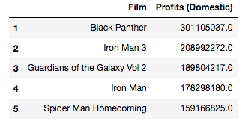
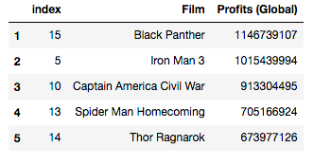
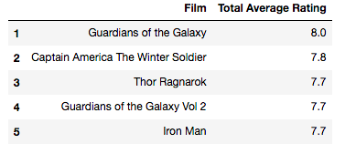
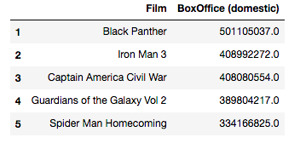
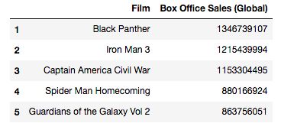
Top 5
Profits
Highest Rated Films
Sales
What Are We Looking At?
As you can see here, the top five films in sales and profits, aside from Guardians of the Galaxy Vol 2, are not ranked in the top five highest rated films. Thus, there is not a strong correlation between sales and viewer ratings.
"This product uses the TMDb API but is not endorsed or certified by TMDb."

Slide 10

Most Profitable Character
Main Character | Avg Sales/Movie
Black Panther | 301,105,037
Iron Man | 166,449,295
Spider-Man | 159,166,825
Starlord | 145,198,361
Captain America | 84,451,151
Doctor Strange | 67,630,718
Thor | 67,448,801
Ant-Man | 31,325,482
The Hulk | (15,481,610)
We wanted to figure out which character was most profitable, but upon reviewing their salaries, we discovered that it increases dramatically with every sequel. Thus is would not be meaningful to compare across characters with only one release.

Slide 11
Salary Comparison
We wanted to take a look at the relationship between the actors’ salaries per movie, but upon reviewing their salaries, we discovered that it increases dramatically with every sequel. Thus is would not be meaningful to compare across characters with only one release.
Additionally, the star status of the actors appears to skew the data. For instance Benedict Cumberbatch in Doctor Strange.

Slide 12
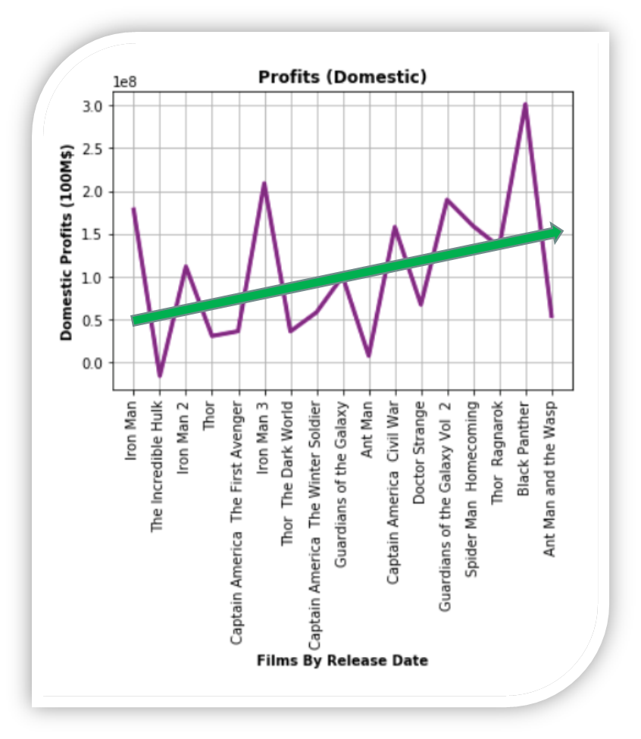
Conclusion
Overall, there is a positive correlation between Marvel’s investments (movie budgets) and box office sales. This was indeed expected.
What was surprising however, was our analysis of viewer ratings. There does not appear to be a correlation between viewer ratings and box office sales.
Notes:
Discuss your findings. Did you find what you expected to find? If not, why not? What inferences or general conclusions can you draw from your analysis?

Slide 13

Global Profits $ 18,339,676,331

Slide 14
Challenges & Questions
Challenges:
API’s:
Tried a number of box office API’s, but data was inconsistent
Had to use two API’s due to incomplete data from first one
Reliability, accuracy , and availability of data:
Budgets
Viewer Ratings
Comparability of the films (single vs multi characters; domestic vs global)
Additional Question:
Do viewers rating is different platforms have an impact on box office sales?
Maybe look at social media trends: mentions on Twitter, Facebook, Instagram
Salaries
Marketing budget: look at where they invested their money
Community Outreach: Marvel conventions, Groups, MeetUps
Notes:
Discuss any difficulties that arose, and how you dealt with them
Discuss any additional questions that came up, but which you didn't have time to answer: What would you research next, if you had two more weeks?

Slide 15
Questions
We’re not taking any…

